Slide 1

Notes:
#

Slide 2



Crystal Quantum Shield Information Security (InfoSec) Team: Perfect Cube
College: Pranveer Singh Institute of Technology, Kanpur Date: 19/08/2024

Slide 3
Problem Overview
Escalating API Attacks: APIs are increasingly vulnerable to sophisticated cyber threats like authentication hijacking, injection attacks, and data exposure. A 348% rise in malicious API calls highlights the urgent need for improved security measures.
Despite advancements in security protocols, organizations continue to experience frequent and sophisticated API attacks. These include authentication hijacking, injection attacks, and data exposure, leading to unauthorized access, data breaches, and service disruptions.
Key Findings/Recommendations:
Critical Gaps: Existing defenses are often inadequate, particularly against business logic flaws and runtime vulnerabilities.
Advanced Measures: AI-driven threat detection, enhanced encryption, and robust access control are essential. Emphasize a lifecycle approach to security, from design to deployment.
Current Defenses: Traditional security measures such as Web Application Firewalls (WAFs) and API gateways are insufficient on their own, as they often fail to address business logic flaws and runtime vulnerabilities.
Lifecycle Approach: Security must be embedded throughout the API lifecycle—from design and development to deployment and monitoring. This includes adopting a "shift left" strategy to address security early in the development process, combined with "shield-right" practices for runtime protection.

Slide 4
Proposed Solution
The proposed API security solution is strategically designed to address the OWASP Top 10 vulnerabilities through a robust and flexible security architecture. It secures core API modules—Login, Product, Inventory, and Payment against common threats like injection attacks, broken authentication, and sensitive data exposure.
The solution leverages novel CRYSTAL Post Quantum algorithms for both encryption and authentication, ensuring that sensitive data is securely scrambled during transmission and storage. Role-Based Access Control (RBAC) is employed to strictly manage user permissions, granting access based on roles to minimize the risk of unauthorized access.
NGINX, HAProxy, AWS API Gateway, etc. serves a dual purpose in this architecture: as a reverse proxy, it manages and filters incoming traffic, applying filters, managing timeouts, and injecting necessary headers to enhance security. It also functions as a proxy server, directing requests to the appropriate backend services and providing an additional layer of security by isolating backend systems from direct exposure. Proxy filters within the system handle missing parameters by assigning default values, ensuring data integrity and consistency.
A key strength of this solution is its seamless integration with existing corporate software, making it easy to enhance API security within a broader IT ecosystem. This integration capability ensures that the security features can be implemented without disrupting existing workflows or requiring significant changes to the corporate infrastructure.
To support continuous security monitoring, the solution includes a user-friendly visualization dashboard. This dashboard tracks key metrics such as the number of users, roles, permissions, traffic patterns, and security events like failed login attempts, encryption activities, and authentication outcomes using neural networks. This allows administrators to monitor API security in real-time, ensuring quick detection and response to potential threats. By combining advanced security techniques with seamless integration and comprehensive monitoring, this solution delivers a secure, resilient, and easily manageable API environment, tailored to fit within corporate IT frameworks.

Slide 5
Implementing CRYSTAL Kyber and CRYSTAL Dilithium
( Post-Quantum Cryptography ) :
Crystal Kyber is a key encapsulation mechanism (KEM) designed to provide secure encryption and key exchange, even in the face of quantum computing threats. It uses lattice-based cryptography, which is resistant to attacks from quantum computers, making it ideal for securely exchanging keys in API communications.
Use in API Security: Kyber can be used to secure data transmission between clients and servers by encrypting sensitive data and ensuring that only authorized parties can decrypt and access it, providing strong protection for API communications.
Crystal Dilithium is a digital signature algorithm that provides authentication and data integrity protection. Like Kyber, it is based on lattice-based cryptography and is resistant to quantum attacks. Dilithium ensures that the data or code exchanged in API interactions is authentic and has not been tampered with.
Use in API Security: Dilithium can be employed to sign API requests and responses, ensuring that only authorized parties are interacting with the API and that the data has not been altered, thus protecting against unauthorized access and data manipulation.
These algorithms ensure that APIs remain secure against both classical and quantum threats
Combining CRYSTALS-Kyber and CRYSTALS-Dilithium can provide a robust security framework for APIs:
Session Establishment: Use CRYSTALS-Kyber to securely exchange a symmetric key for the session.Encrypt subsequent communications using this symmetric key.
Authenticated API Calls: Each API request and response is signed with CRYSTALS-Dilithium to ensure authentication and data integrity.Clients and servers verify each other’s signatures to prevent unauthorized access and data tampering.
Secure Data Transmission: Encrypt data using the symmetric key established by CRYSTALS-Kyber. Sign data using CRYSTALS-Dilithium to ensure it is not modified during transmission.

Slide 6
Addressing the OWASP Top 10 Risks with Our Advanced Mitigation Strategies :
Broken Access Control: Implementing role-based access control (RBAC) directly addresses this risk by ensuring that users can only access resources they are authorized to. RBAC ensures that unauthorized users cannot access or manipulate data beyond their privileges.
Cryptographic Failures: Using Crystal algorithms for encryption and authentication addresses this risk by ensuring your API uses strong, quantum-resistant cryptographic techniques. This mitigates risks associated with weak encryption, ensuring data confidentiality and integrity.
Injection: While not explicitly mentioned, the use of scrambling tokens and proxy servers can help mitigate injection risks by adding layers of obfuscation and inspection. Proxies can filter out malicious requests, and scrambling tokens can prevent attackers from exploiting predictable patterns.
Insecure Design: The comprehensive security strategy you've outlined, including multi-layer proxies, rate limiting, and secure cryptographic practices, shows a proactive approach to secure design. Addressing security at the design stage reduces the risk of vulnerabilities due to poor architecture or logic flaws.
Security Misconfiguration: By using a cloud service or API gateway, you can leverage their built-in security configurations and best practices. Ensures that your API is not exposed due to misconfigured security settings.
Vulnerable and Outdated Components: Regularly updating your proxy servers and cryptographic libraries as part of your maintenance ensures you are not using outdated components. Keeping all components up-to-date mitigates the risk of exploitation through known vulnerabilities.
Identification and Authentication Failures: Crystal Dilithium for authentication helps protect against weak authentication mechanisms. Strong authentication reduces the risk of unauthorized access due to weak passwords, session management issues, or brute force attacks.
Software and Data Integrity Failures: The use of cryptographic techniques and multiple proxy layers helps ensure that the data and software integrity are maintained.Prevents unauthorized manipulation of data or software within your API environment.
Security Logging and Monitoring Failures: Implementing logging and monitoring across proxy layers directly addresses this risk, enabling you to detect and respond to security incidents promptly.Comprehensive logging and monitoring are critical for detecting breaches and responding to security events.
Server-Side Request Forgery (SSRF): The use of proxy servers can help mitigate SSRF risks by filtering and validating outbound requests before they reach internal systems. Proxies can help control and restrict internal resources from being accessed or manipulated through SSRF attacks.

Slide 7
Positive Impacts of CQS:
Enhanced Security Against OWASP Top 10 Vulnerabilities: Reduces the likelihood of successful attacks, protecting sensitive data and maintaining digital asset integrity.
Improved Data Protection: Ensures sensitive data is protected both in transit and at rest, enhancing compliance with data protection regulations.
Strengthened Access Control: Enforces strict user permissions, minimizing insider threats and unauthorized access.
Increased Operational Resilience: Enhances system stability and performance through traffic management and security filtering.
Seamless Integration with Corporate Software: Allows advanced security measures without extensive IT infrastructure modifications, reducing implementation costs and downtime.
Real-Time Security Monitoring: Provides proactive insights into API security, enabling quick response to incidents and reducing breach impact.
Increased Trust and Compliance: Builds trust with stakeholders and helps meet regulatory requirements for data security.
Cost Savings: Avoids expenses associated with breaches and reduces costs through seamless integration.
Scalability and Flexibility: Adapts to organizational growth, ensuring continued protection without performance compromise.
Increased User Confidence: Enhances user trust and satisfaction with secure API interactions.
The solution fortifies defenses, improves operational efficiency, and supports compliance, making it essential to the organization's cybersecurity strategy.

Slide 8
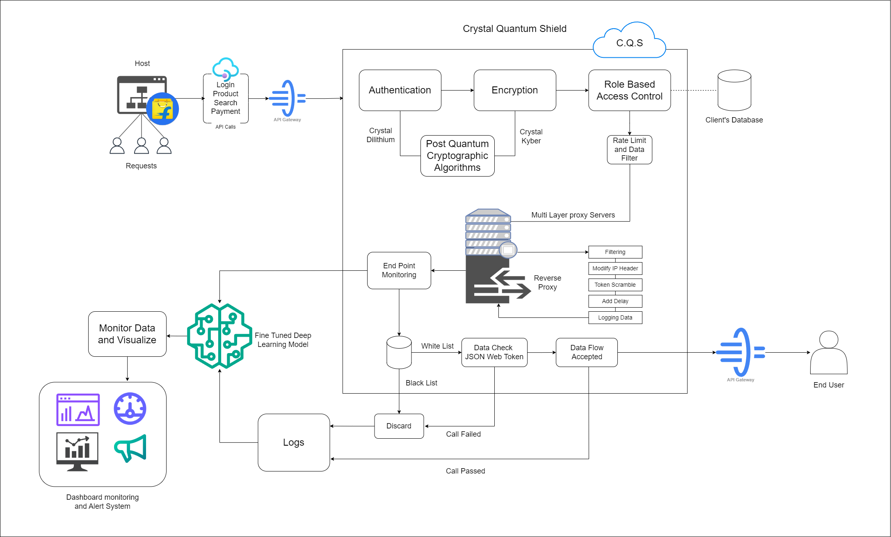
Methodology

Slide 9
Key Components
Authentication (Crystal Dilithium): Implements PQC algorithms for strong, quantum-resistant API authentication.
Encryption (Crystal Kyber): Safeguards data at rest and in transit with post-quantum cryptographic techniques.
Role-Based Access Control (RBAC): Enforces access control with quantum-resistant methods, including rate limiting and data filtering.
Security Workflow
API Gateway: Processes API requests like login, search, and payments.
Multi-Layer Proxy Servers: Reverse proxy for filtering, token scrambling, and secure data flow management.
Endpoint Monitoring: Continuous monitoring to detect anomalies and threats in real-time.
Logs and Visualization: Logs API interactions and uses deep learning for monitoring and alerts.
Future-Ready Security: The C.Q.S framework ensures robust API protection against quantum-era threats.
Tools and Technologies
Python for API development and cryptographic integration,
NGINX as a reverse proxy for secure data handling
Prometheus/Grafana for real-time monitoring and visualization.
TensorFlow or PyTorch are used for deep learning
OAuth 2.0 and JWT manage secure API authentication.
Docker and Kubernetes facilitate containerization and orchestration.
CloudWatch for Alert System.

Slide 10
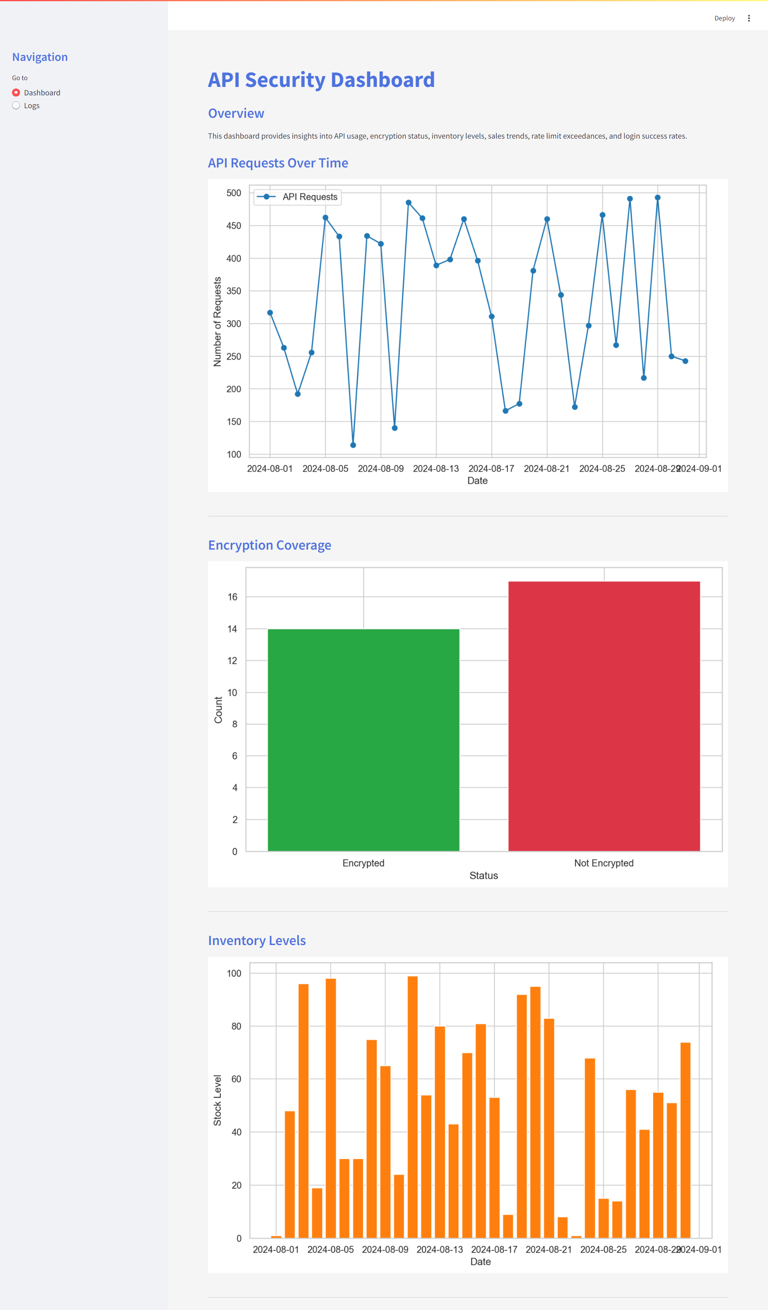
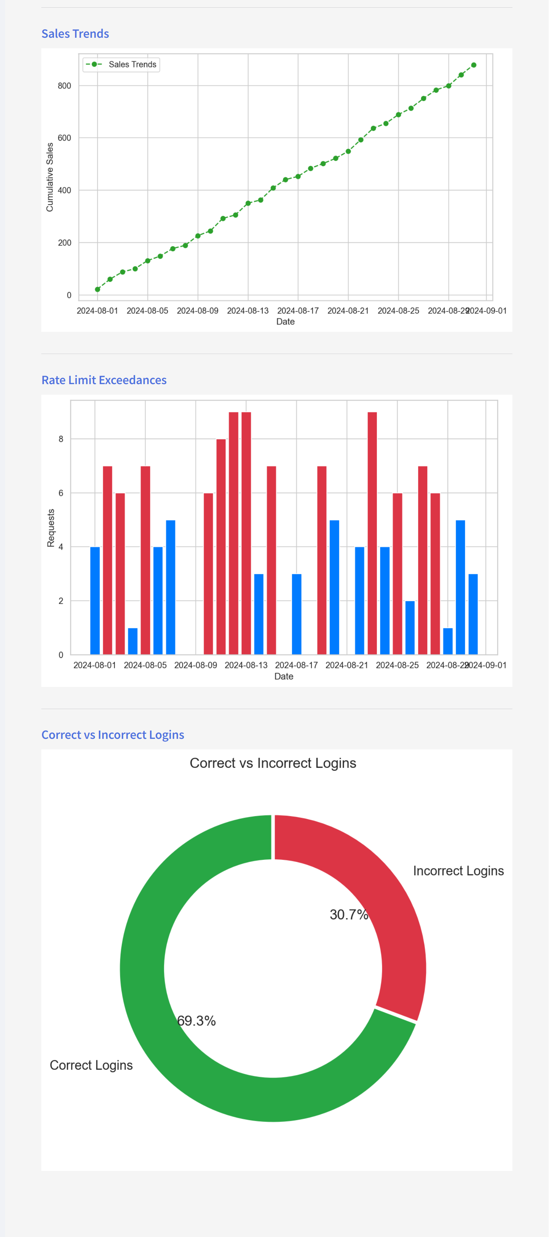
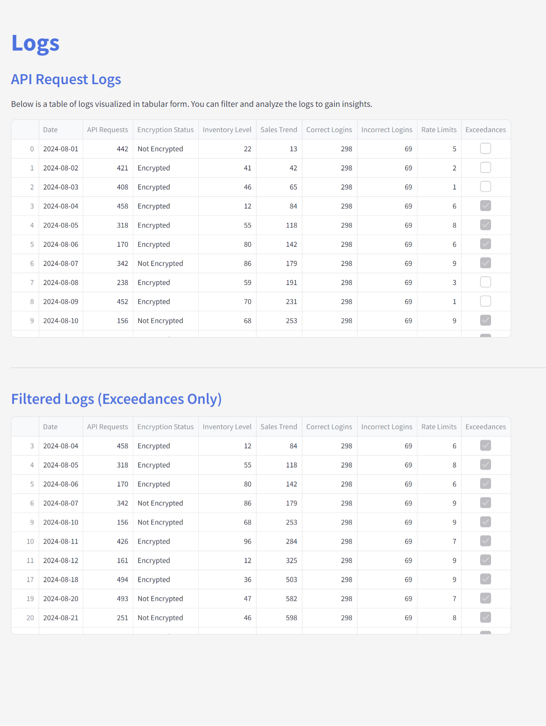
Result and Analysis : Pre-Development Dashboard Insights

Slide 11
Challenges and Limitations in Development
Integration Complexity: Difficulty integrating with diverse technology stacks and legacy systems.
Performance Trade-offs: Balancing security enhancements with maintaining optimal system performance and latency.
Scalability Issues: Ensuring the solution scales effectively with growing traffic and user demands.
Resource Constraints: Limited skilled personnel in advanced encryption and secure API design.
Security Testing Challenges: Difficulty conducting comprehensive security testing across all API endpoints.
Recommendations and Future Work
Continuous Security Enhancements: Implement automated security testing in a CI/CD pipeline.
Performance Optimization: Continuously optimize configurations to reduce latency without compromising security.
Scalability Improvements: Modularize components and use cloud-native solutions for dynamic scalability.
Enhanced User Training: Provide ongoing training to keep developers updated on the latest security practices.
Expanded Security Coverage: Broaden security testing to include real-world scenarios and edge cases.
User Feedback and Iteration: Establish a feedback loop to gather insights and drive iterative improvements.
Explore Generative AI: Investigate generative AI for automating security code generation and improving threat modeling.

Slide 12
References & Citations
Hekkala, J., Muurman, M., Halunen, K., & Vallivaara, V. (2023). Implementing Post-quantum Cryptography for Developers. SN Computer Science, 4(4) https://doi.org/10.1007/s42979-023-01724-1
Avanzi, R., Bos, J., Ducas, L., Kiltz, E., Lepoint, T., Lyubashevsky, V., Schanck, J. M., Schwabe, P., Seiler, G., & Stehlé, D. (2021). CRYSTALS-Kyber Algorithm Specifications And Supporting Documentation (version 3.01). https://pq-crystals.org/kyber/data/kyber-specification-round3-20210131.pdf
API Security: Threats, Best Practices, Challenges, and Way forward using AI. (2023).
Rahman, I., Paramitha, R., Plate, H., & Williams, L. (2024). Less Is More: A Mixed-Methods Study on Security-Sensitive API Calls in Java for Better Dependency Selection. ResearchGate. https://www.researchgate.net/publication/382914543_Less_Is_More_A_Mixed-Methods_Study_on_Security-Sensitive_API_Calls_in_Java_for_Better_Dependency_Selection
Aharon, U., Dubin, R., Dvir, A., & Hajaj, C. (n.d.). Few-Shot API Attack Anomaly Detection in a Classification-by-Retrieval Framework.https://www.researchgate.net/publication/380730002_Few-Shot_API_Attack_Anomaly_Detection_in_a_Classification-by-Retrieval_Framework
Sun, R., Wang, Q., & Guo, L. (2022). Research Towards Key Issues of API Security. In Communications in computer and information science (pp. 179–192). https://doi.org/10.1007/978-981-16-9229-1_11

Slide 13
